Slide 1
Dialogue Summarization
A survey on what works and what’s next
By Mayuri Lalwani

Slide 2
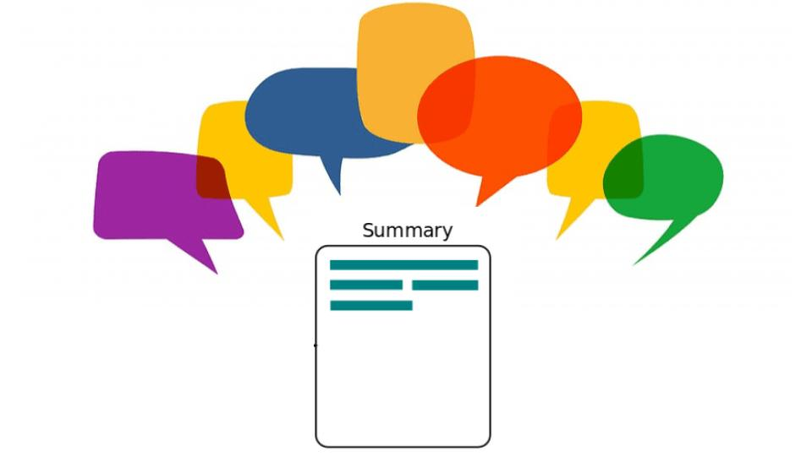
What is Dialogue Summarization and Why is it Needed?

Slide 3
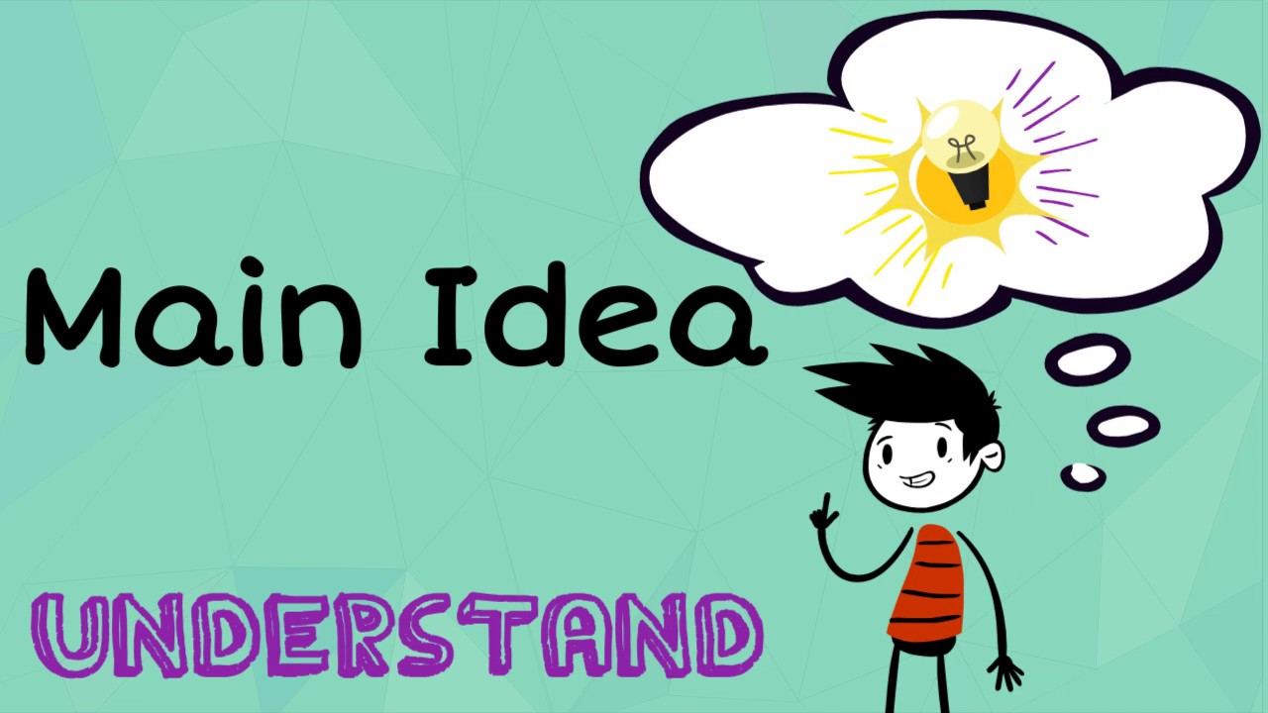
What is Document Summarization and Methods

Slide 4
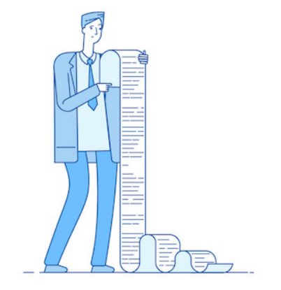
Problems with long inputs with classical Transformers

Slide 5
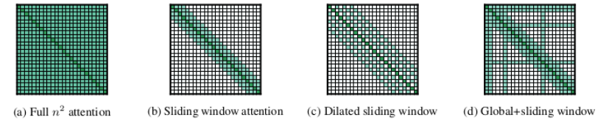
Longformer- Encoder- Decoder (LED)

Slide 6
HMNet
Hierarchical Meeting Summarization Network.
A method of generating summaries for meetings.
The meeting summarization task bears a number of challenges.
The transcript and summary of a single meeting are usually much longer than those of a document.
A meeting is carried out between multiple participants.

Slide 7
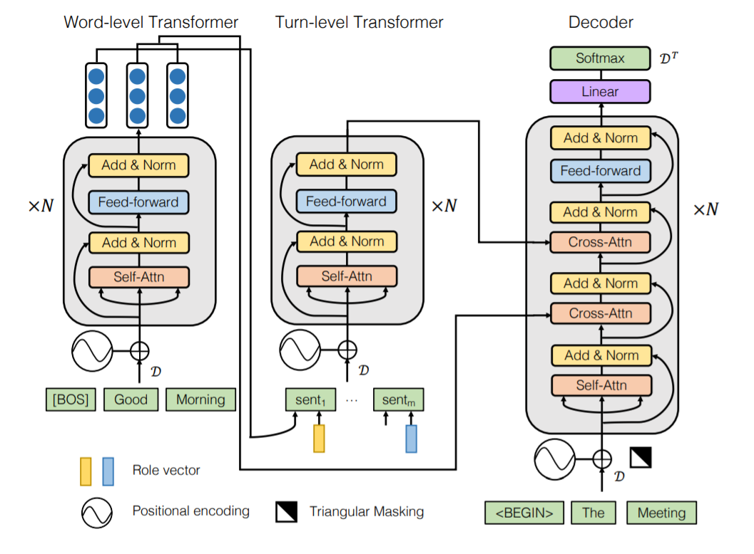

Slide 8
Retrieve Then Summarize
This is a two stage process.
It first retrieves the most relevant subtext from the dialogue.
Second, it feeds this subtext to a summarizer.
Different retrievers can be used for this process:
TF-IDF
BM25
Locator
The output of the of various retrievers can be fed to a fine tuned BART model to generate a summary.

Slide 9

Evaluation Metrics

Slide 10
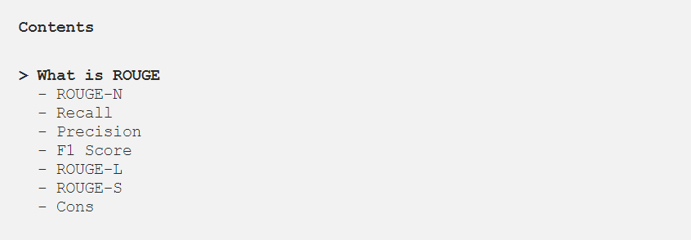
ROGUE
MoverScore
BERTScore

Slide 11
New Frontiers and Challenges
Multi-modal Dialogue Summarization.
Multi-domain Dialogue Summarization.

Slide 12


